Slide 1
SQL Analysis Project
Pizza Store Sales

Slide 2
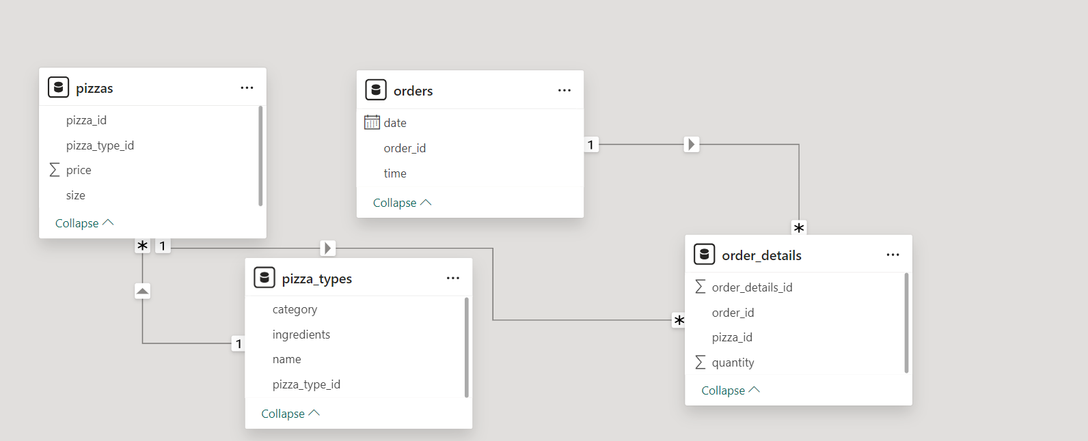
Data Model

Slide 3
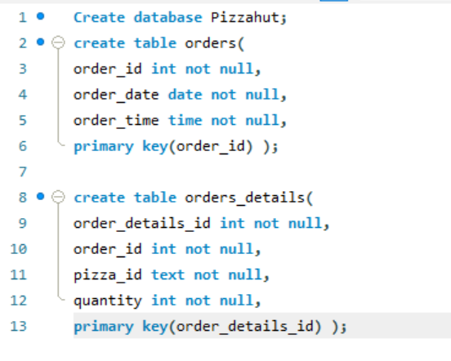
Creating Database in Postgre-SQL

Slide 4
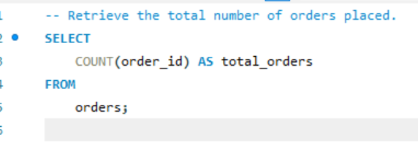
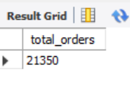
SQL queries to Analyse sales
INPUT
OUTPUT

Slide 5
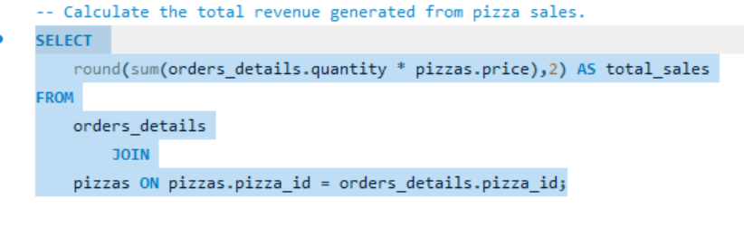

SQL queries to Analyse sales
INPUT
OUTPUT

Slide 6
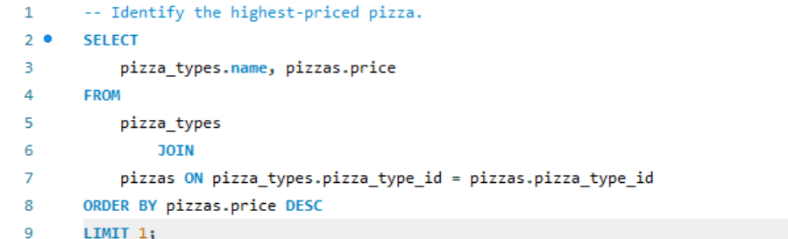
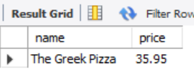
SQL queries to Analyse sales
INPUT
OUTPUT

Slide 7
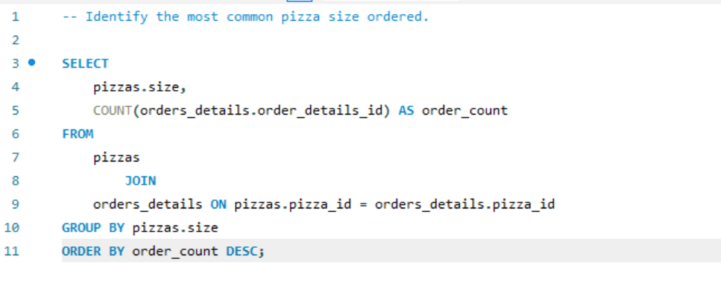
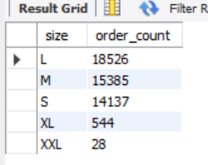
SQL queries to Analyse sales
INPUT
OUTPUT

Slide 8
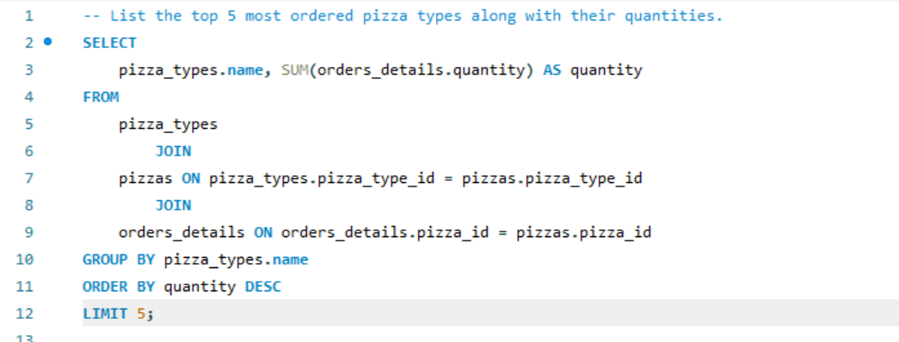
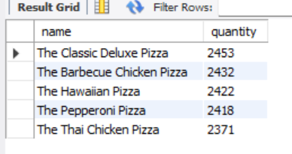
SQL queries to Analyse sales
INPUT
OUTPUT

Slide 9
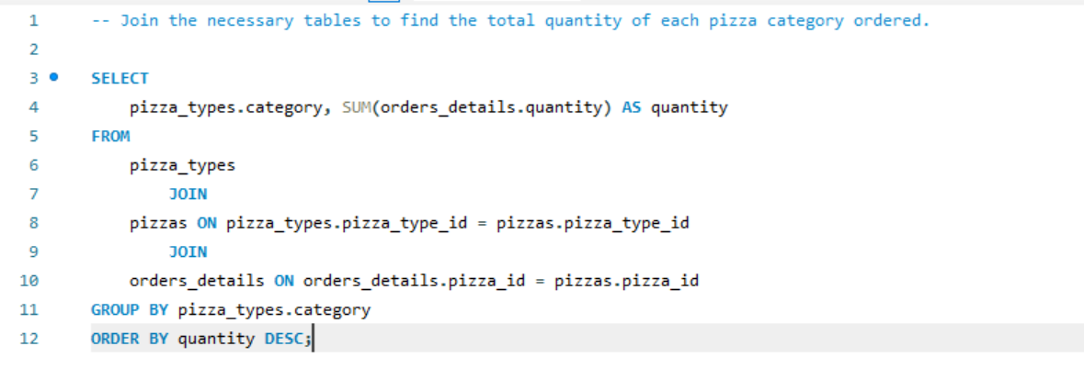
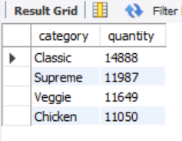
SQL queries to Analyse sales
INPUT
OUTPUT

Slide 10
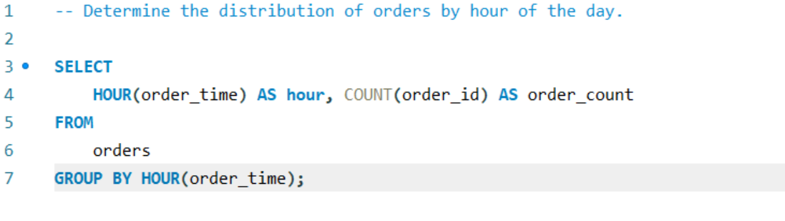
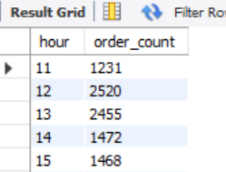
SQL queries to Analyse sales
INPUT
OUTPUT

Slide 11
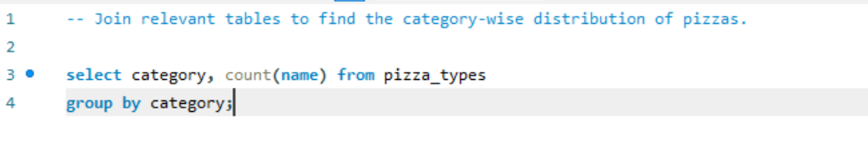
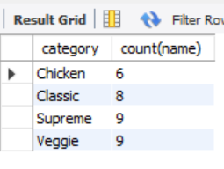
SQL queries to Analyse sales
INPUT
OUTPUT

Slide 12
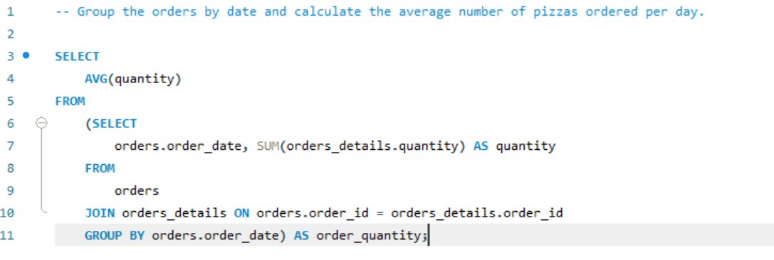
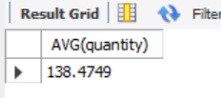
SQL queries to Analyse sales
INPUT
OUTPUT

Slide 13
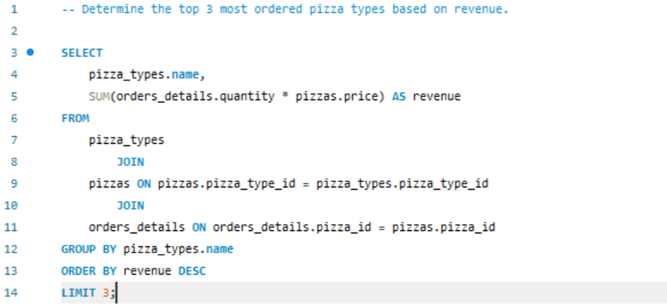
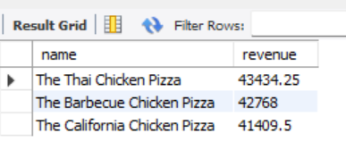
SQL queries to Analyse sales
INPUT
OUTPUT

Slide 14
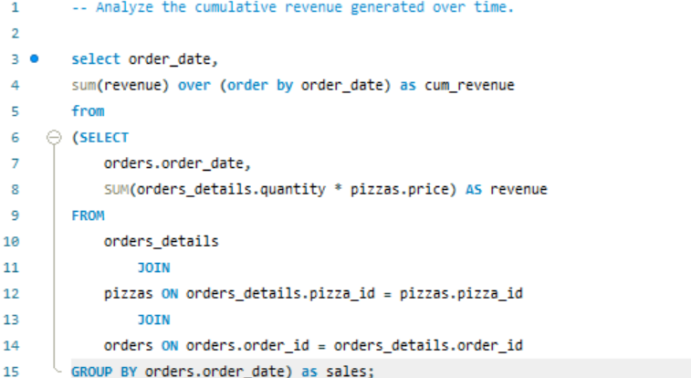
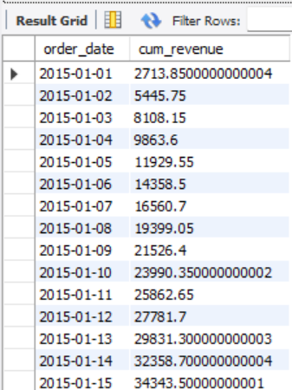
SQL queries to Analyse sales
INPUT
OUTPUT

Slide 15
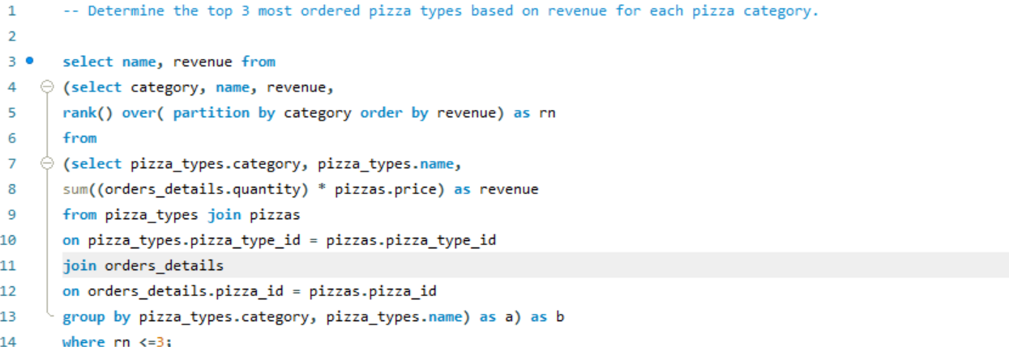
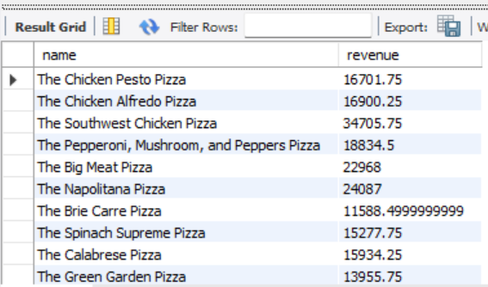
SQL queries to Analyse sales
INPUT
OUTPUT

Slide 16
Conclusion
The analysis provides actionable insights for increasing the pizza store's sales by identifying key sales drivers and segmenting customers effectively. Product performance and operational efficiency improvements were highlighted, guiding menu optimization and cost control. Evaluations of past marketing campaigns offer refined future strategies.

